Slide 1
Criminal Justice Incentive Pay (CJIP)
Jamie Johnson & Jennifer Bond
Human Resources

Slide 2
Solving the mystery…
What is Criminal Justice Incentive Pay?
CJIP was approved by the Legislature in 1977 and amended in 1980 and 1981.
The Criminal Justice Incentive Program (CJIP) is designed to give a supplemental salary payment to investigators, law enforcement and correctional officers to reward educational and other career development activities that go beyond minimum position requirements.

Slide 3
Solving the mystery continued…
Eligibility
  Pay Plan 82
  Class Codes:
    6661 Investigator I
    6662 Investigator II
    6663 Investigator III
    6664 Investigator IV.

Slide 4
How is it paid…
CJIP is paid as a supplemental payment that must be set up in People First as a recurring payment.
CJIP - Supplemental Payment Amounts
  Minimum payment is $25.00 a month
  Maximum payment is $130.00 a month.

Slide 5
How is pay determined…
Pay is based on two categories:
Basic Certification: An employee is eligible to receive the basic certification amount of $25.00 if they received certification prior to July 1, 1980 or for an officer who is reactivated upon reappointment and their original certification was received prior to July 1, 1980.

Slide 6
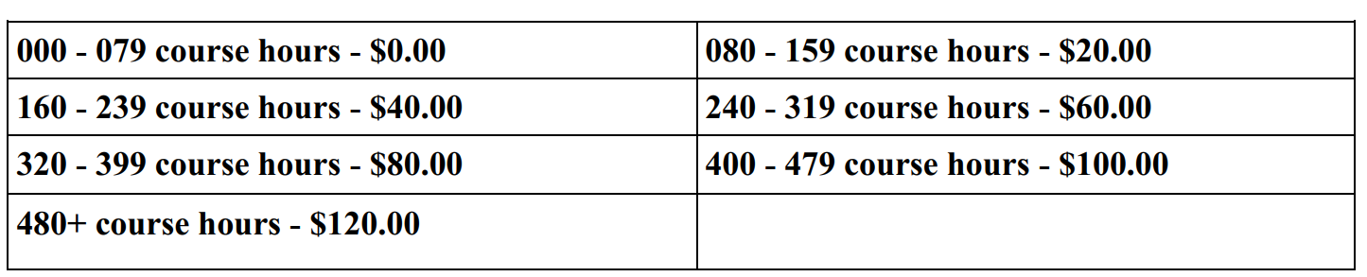
How is pay determined continued…
2. Career Development: An employee receives $20.00 for every 80 hours of FDLE approved courses completed. Employee cannot receive more than $120.00 for completed courses.

Slide 7
Required forms for CJIP…
https://www.justiceadmin.org/HR/pay.aspx
Florida Department of Law Enforcement (FDLE) - Criminal Justice Professionalism Program Global Profile Sheet.
CJIP – Class Code/Position Number Table Maintenance Request (JAC CJIP Form).
Must be indicated on the position description.

Slide 8
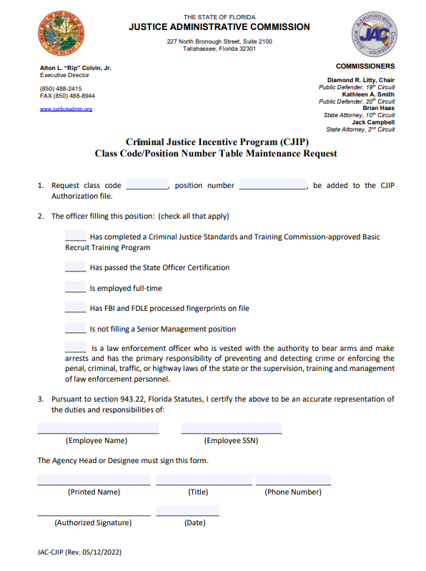
Required forms continued…

Slide 9
Required forms continued…

Slide 10
Required forms continued…

Slide 11
When does CJIP Pay…
Investigators receive their monthly salary warrant, they will also receive their monthly CJIP warrant.
Per 11B-14.002(4)3, F.S., salary incentive payments paid to officers employed by the State of Florida shall begin in the first full calendar month following the initial date of eligibility.
Example: Officer becomes eligible for the incentive payment 2/5/2018, the recurring payment must be set up 3/1/2018.
B-14.002(6) F.A.C. specifically does not allow retroactive CJIP Payments.

Slide 12
Key Takeaways…
Must be in an eligible pay plan and class code.
FDLE Global Profile Sheet determines the pay amount.
All required forms must be submitted.
Work a full calendar month to receive first payment.
Paid Monthly.

